Slide 1
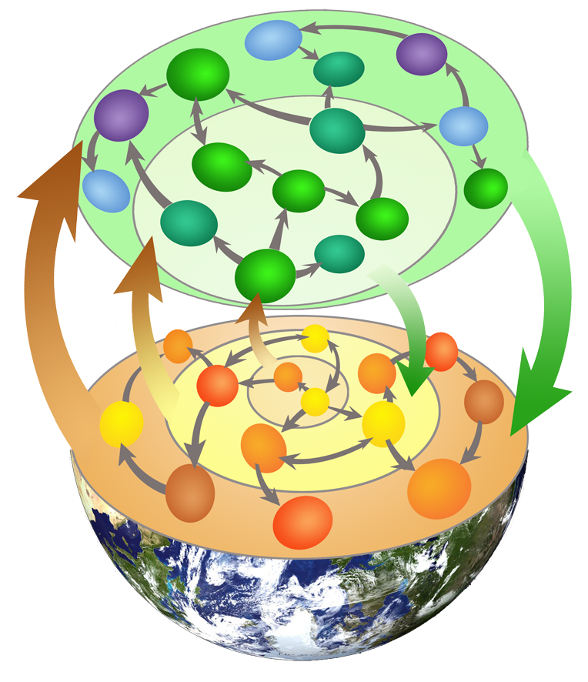
Ecosystem Assembly Model
Workshop Theoretical Ecology, Rimouski
Tuesday August 27th 2013

Slide 2
Principle of assembly models
regional species pool
assembly
process
locality
…

Slide 3
Principle of assembly models
regional species pool
assembly
process
locality
…
Issues
assembly mechanisms :
assembly process - transient community states
historical contingencies
invasion issues ...
community / ecosystem coexistence:
ecosystem functioning
Diversity – ecosystem relationship ...

Slide 4
Structure of the ecosystem model
Mechanistisms
of ecosystem functioning:
2 webs
autoroph
detritivorous
recycling

Slide 5
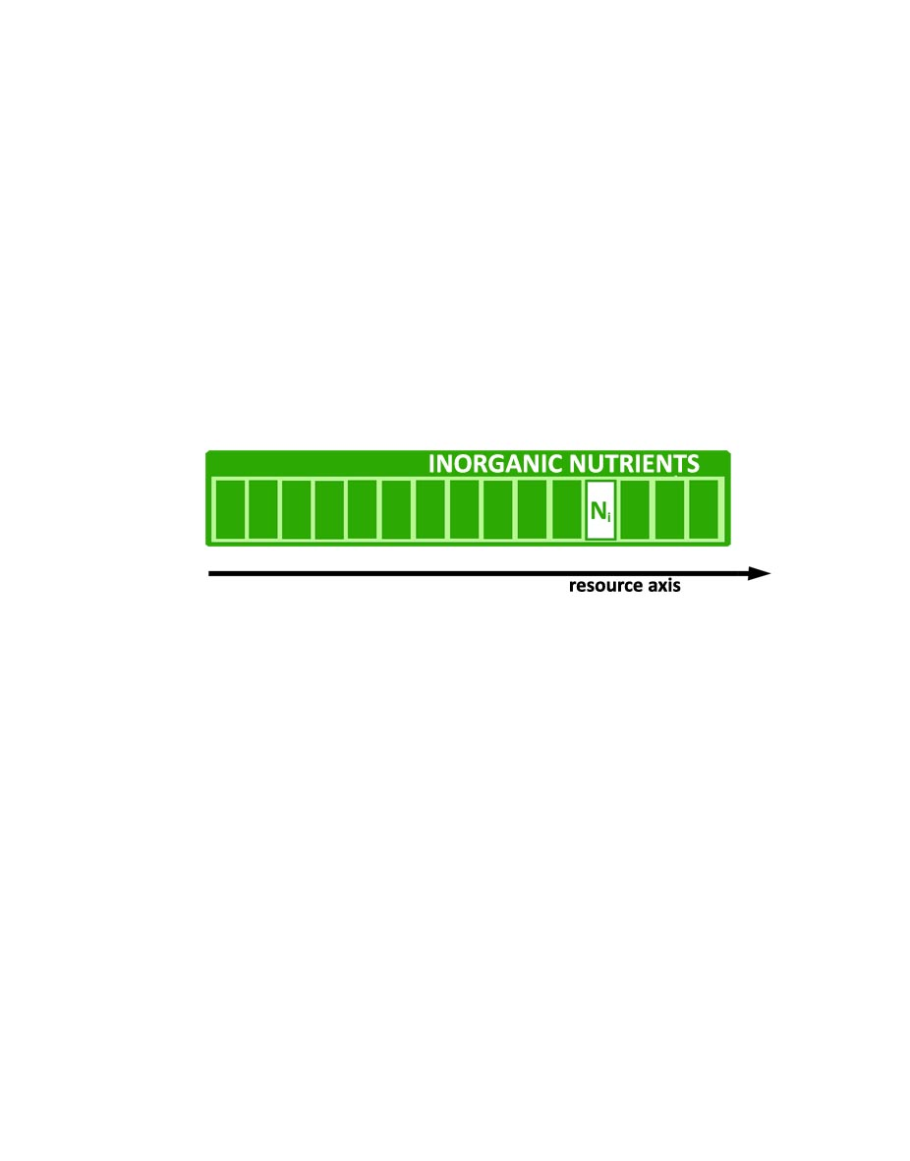
Structure of the ecosystem model
inorganic nutrient classes
producers and consumers
body-mass axis
production of detritus
detritivorous web
production of inorganic nutrients
importation - exportations

Slide 6
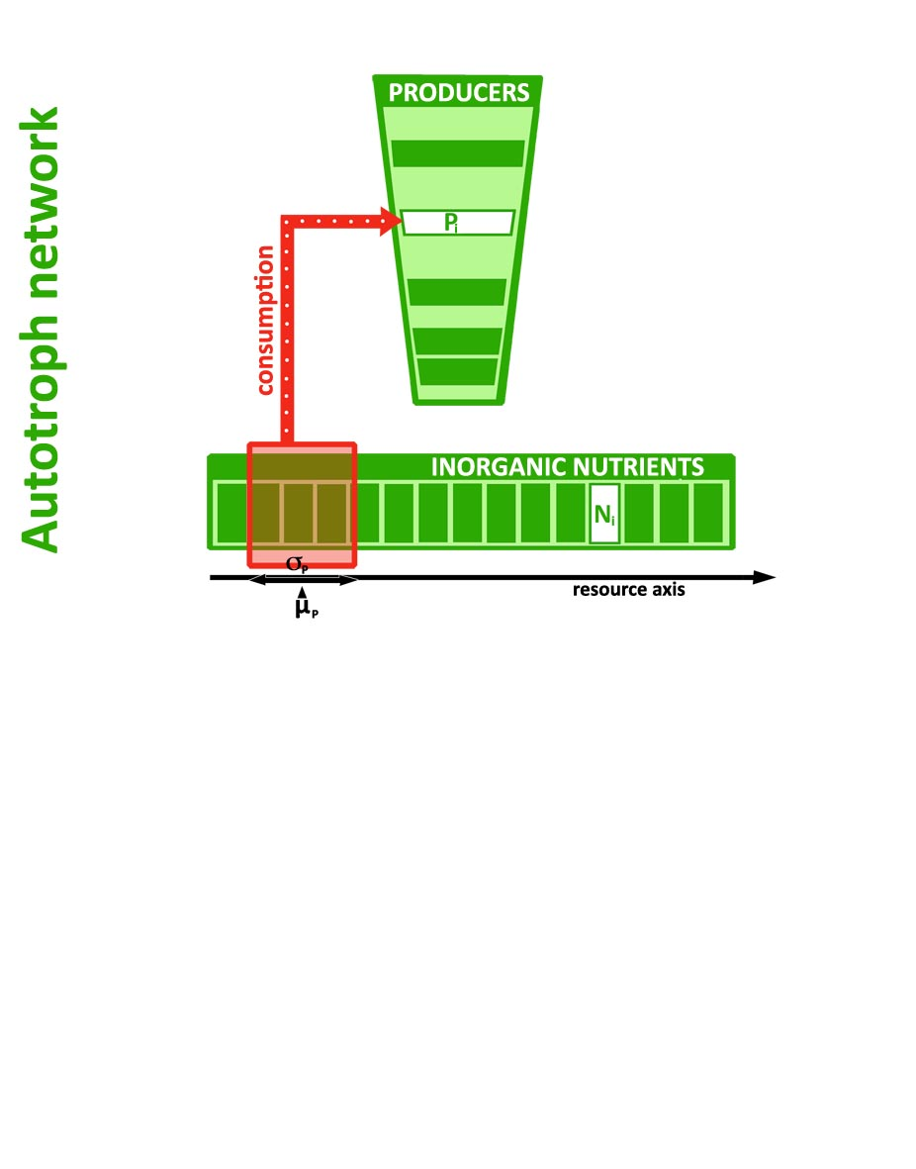
Structure of the ecosystem model
inorganic nutrient classes
producers and consumers
body-mass axis
production of detritus
detritivorous web
production of inorganic nutrients
importation - exportations

Slide 7
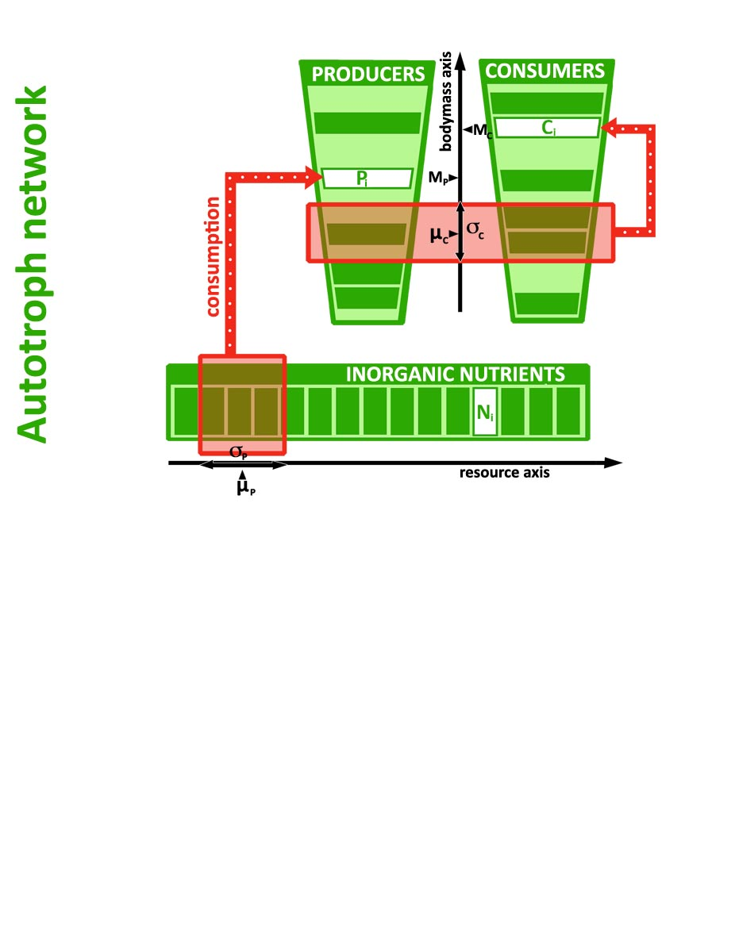
Structure of the ecosystem model
inorganic nutrient classes
producers and consumers
body-mass axis
production of detritus
detritivorous web
production of inorganic nutrients
importation - exportations

Slide 8
Structure of the ecosystem model
inorganic nutrient classes
producers and consumers
body-mass axis
(Brose et al. 2006)
Q_{0.9}
Q_{0.1}
r
log Bodymass prey
log Bodymass predator

Slide 9
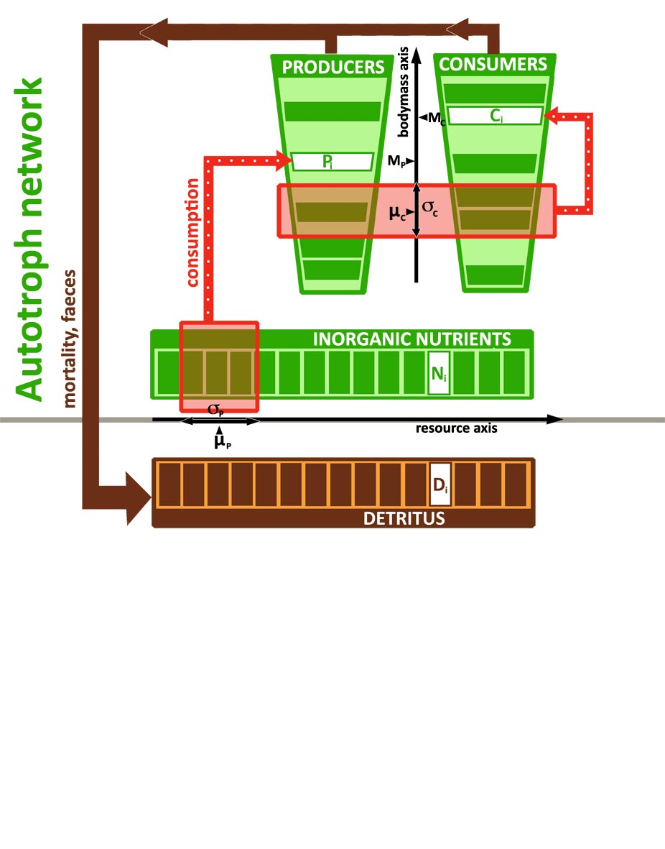
Structure of the ecosystem model
inorganic nutrient classes
producers and consumers
body-mass axis
production of detritus
detritivorous web
production of inorganic nutrients
importation - exportations

Slide 10
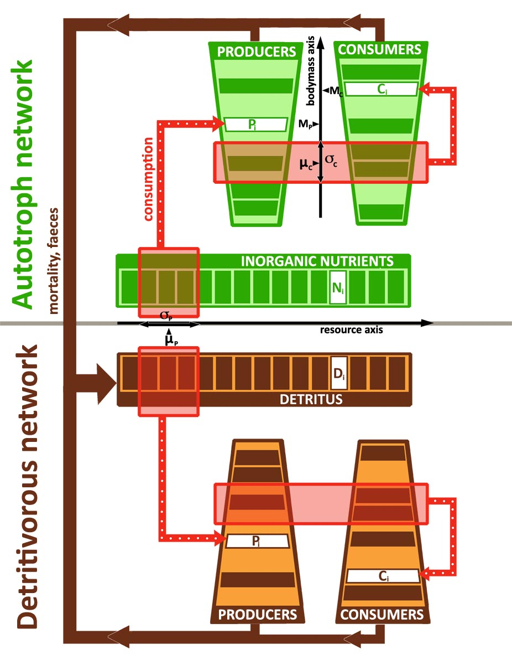
Structure of the ecosystem model
inorganic nutrient classes
producers and consumers
body-mass axis
production of detritus
detritivorous web
production of inorganic nutrients
importation - exportations

Slide 11
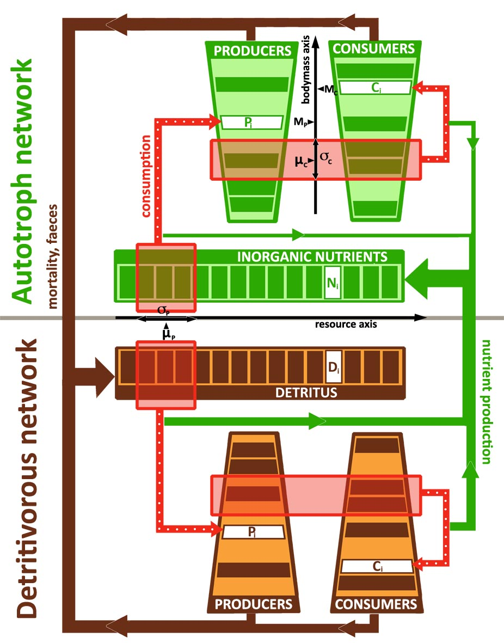
Structure of the ecosystem model
inorganic nutrient classes
producers and consumers
body-mass axis
production of detritus
detritivorous web
production of inorganic nutrients
importation - exportations

Slide 12
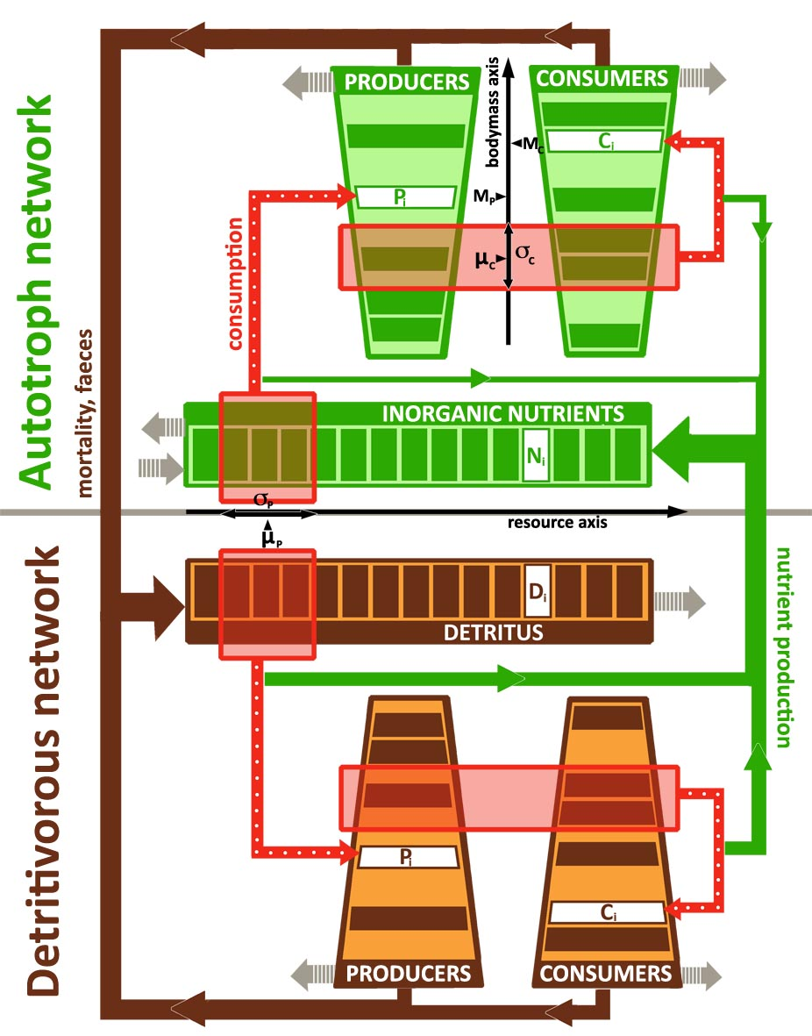
Structure of the ecosystem model
inorganic nutrient classes
producers and consumers
body-mass axis
production of detritus
detritivorous web
production of inorganic nutrients
importation - exportations

Slide 13
Ordinary Differential Equations
4 types of compartment
C
P
N
D
Notes:
Chaque espèce qui s’installe à une équation

Slide 14
Ordinary Differential Equations
C
P
N
D
Notes:
Chaque espèce qui s’installe à une équation

Slide 15
Ordinary Differential Equations
C
P
N
D
Notes:
Chaque espèce qui s’installe à une équation

Slide 16
Ordinary Differential Equations
C
Biological rates
P
(Berlow et al. 2009, Brose et al.2006)
N
D
Notes:
Chaque espèce qui s’installe à une équation

Slide 17
Ordinary Differential Equations
C
Biological rates
P
(Berlow et al. 2009, Brose et al.2006)
N
D
Functional responses
or
Notes:
Chaque espèce qui s’installe à une équation

Slide 18
Ordinary Differential Equations
C
P
N
D
Notes:
Chaque espèce qui s’installe à une équation

Slide 19
Ordinary Differential Equations
C
P
N
D
Notes:
Chaque espèce qui s’installe à une équation

Slide 20
Ordinary Differential Equations
C
P
N
D
Notes:
Chaque espèce qui s’installe à une équation

Slide 21
Ordinary Differential Equations
C
P
N
D
Notes:
Chaque espèce qui s’installe à une équation

Slide 22
Assembly process
species pool or ∞
locality
step 1
empty
(nut & det)

Slide 23
Assembly process
species pool or ∞
locality
step 1
empty
(nut & det)
step 2
first installation

Slide 24
Assembly process
species pool or ∞
locality
step 1
empty
(nut & det)
…
step 2
first installation
…
Stops
no more species in the pool
step max
maximum unsuccessful invasion
endcycles ...
step n
assembly stop

Slide 25
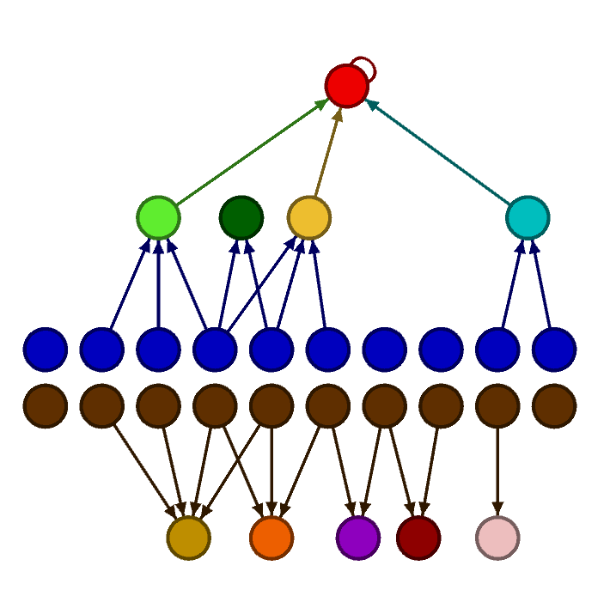
Assembly process
relative species densities
inorganic nutrients
detritus
densities
species
assembly steps

Slide 26
Assembly process
relative species densities
inorganic nutrients
detritus
densities
species
assembly steps

Slide 27
Assembly process
relative species densities
inorganic nutrients
detritus
densities
species
assembly steps

Slide 28
Assembly process
relative species densities
inorganic nutrients
detritus
densities
species
assembly steps

Slide 29
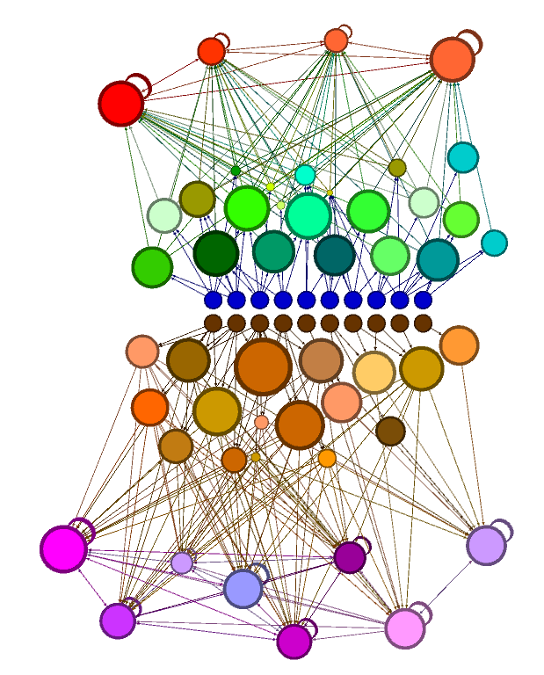
Assembly process
Notes:
pourquoi programme en C plutôt qu’en R : beaucoup plus rapide

Slide 30
C program – Algorithm
Creation of
nutrient and detritus

Slide 31
C program – Algorithm
Creation of
nutrient and detritus
species
Species pool
add a new species
(type, M, ε, e)

Slide 32
C program – Algorithm
Creation of
nutrient and detritus
species
Species pool
add a new species
(type, M, ε, e)
interaction
Interaction matrix

Slide 33
C program – Algorithm
Creation of
nutrient and detritus
species
Species pool
add a new species
(type, M, ε, e)
interaction
Interaction matrix
integration
run the dynamics
runge-kutta
ode’s

Slide 34
C program – Algorithm
Creation of
nutrient and detritus
species
Species pool
add a new species
(type, M, ε, e)
interaction
Interaction matrix
integration
run the dynamics
runge-kutta
remove extincted sp.
ode’s

Slide 35
C program – Algorithm
Creation of
nutrient and detritus
species
for
Species pool
add a new species
(type, M, ε, e)
print outputs
no
interaction
Interaction matrix
Stop conditions
Output files
yes
integration
run the dynamics
if
runge-kutta
remove extincted sp.
ode’s

Slide 36
C program – Structure
Creation of
nutrient and detritus
assembly.c
species
for
Species pool
add a new species
(type, M, ε, e)
print outputs
no
interaction
Interaction matrix
Stop conditions
Output files
yes
integration
run the dynamics
if
runge-kutta
remove extincted sp.
ode’s

Slide 37
C program – Structure
Creation of
nutrient and detritus
assembly.c
species.c
species
for
printoutput.c
Species pool
add a new species
(type, M, ε, e)
print outputs
pool.c
no
interaction
Interaction matrix
Stop conditions
Output files
interaction.c
yes
integration
run the dynamics
if
runge-kutta
integration.c
remove extincted sp.
ode’s

Slide 38
C program – Structure
Creation of
nutrient and detritus
assembly.c
species.c
species
utils.c
for
printoutput.c
Species pool
add a new species
(type, M, ε, e)
print outputs
pool.c
no
interaction
Interaction matrix
Stop conditions
Output files
interaction.c
yes
integration
run the dynamics
if
runge-kutta
integration.c
remove extincted sp.
parameters.h
ode’s

Slide 39
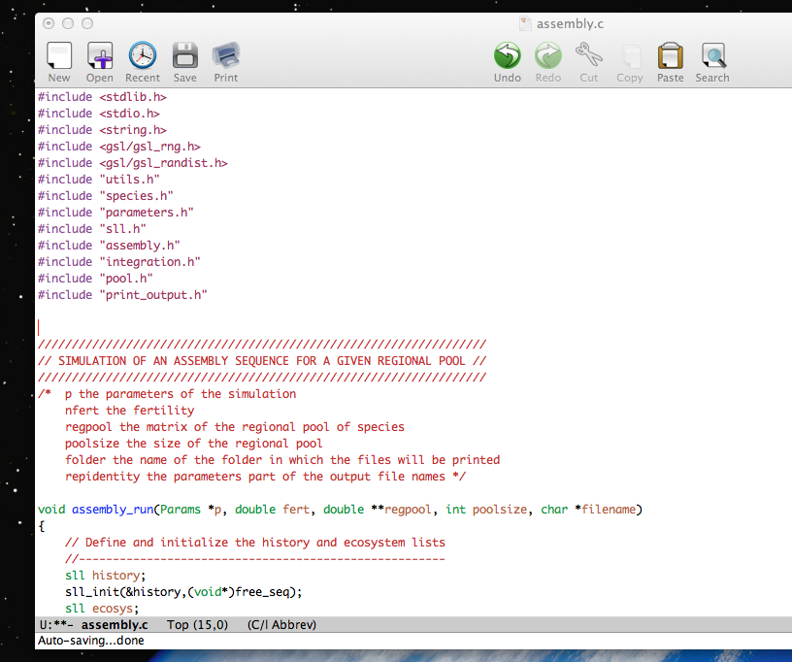
C program – Structure

Slide 40
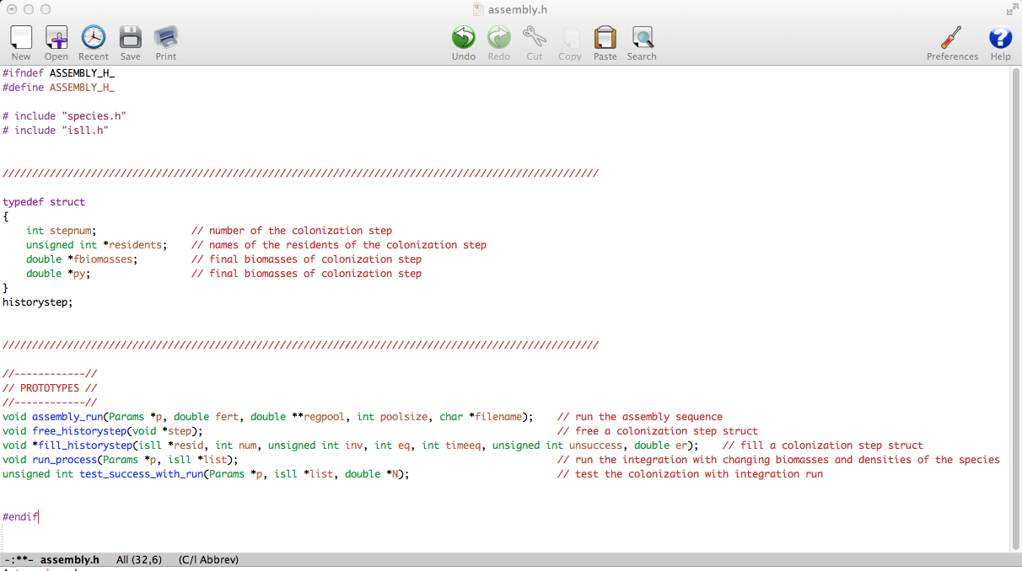
C program – Structure

Slide 41
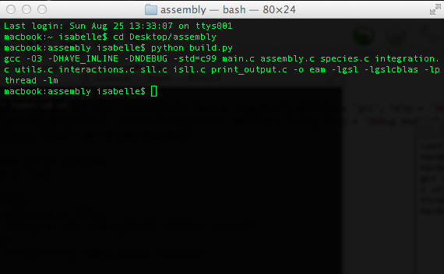
C program – Structure
Compilation

Slide 42
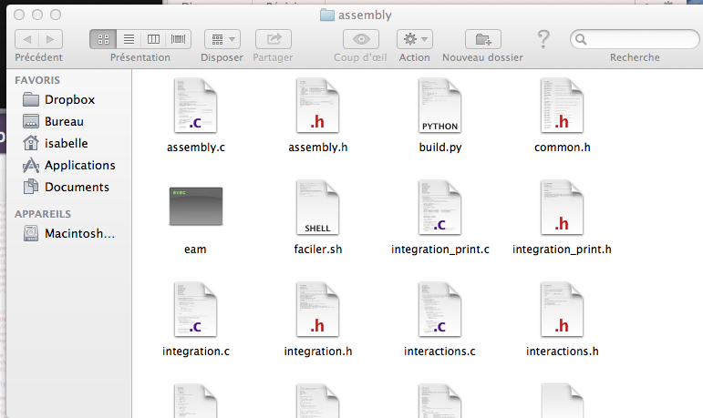
C program – Structure
Compilation

Slide 43
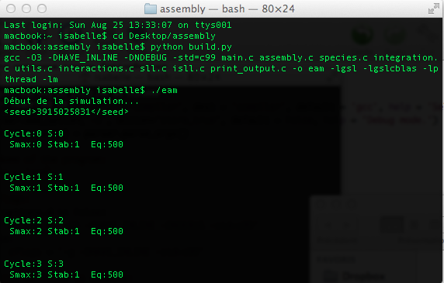
C program – Structure
Execution
Notes:
montrer le programme proie prédateur

Slide 44
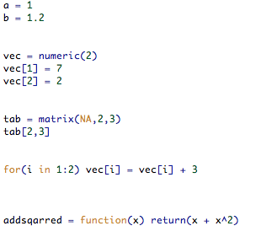
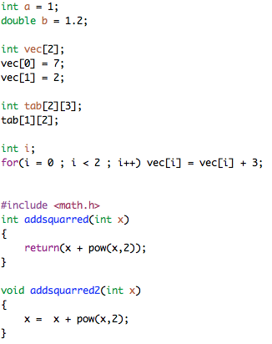
C program – Syntax
R
C

Slide 45
C program – Syntax
R
C

Slide 46
C program – Syntax
R
C

Slide 47
C program – Syntax
R
C

Slide 48
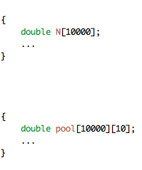
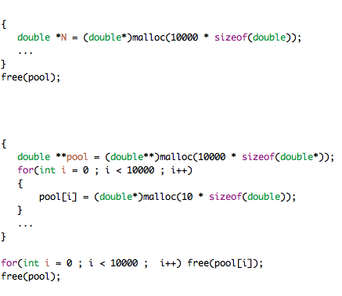
C program – Memory
2 types of memory
STACK
Static memory
Size limited
Reclaimed automatically
HEAP
Dynamical memory
Large size (all computer)
Reclaimed manually

Slide 49
C program – Memory
2 types of memory
STACK
Static memory
Size limited
Reclaimed automatically
HEAP
Dynamical memory
Large size (all computer)
Reclaimed manually

Slide 50
C program – Memory
2 types of memory
STACK
Static memory
Size limited
Reclaimed automatically
HEAP
Dynamical memory
Large size (all computer)
Reclaimed manually

Slide 51
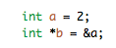
C program – Memory
2 types of memory
Pointers
a
b
HEAP
Dynamical memory
Large size (all computer)
Reclaimed manually
2
345
&345
&647

Slide 52
C program – Memory
2 types of memory
Pointers
a
b
HEAP
Dynamical memory
Large size (all computer)
Reclaimed manually
2
345
&345
&647
N
10000
123
...
&123

Slide 53
C program – Memory
2 types of memory
Pointers
a
b
HEAP
Dynamical memory
Large size (all computer)
Reclaimed manually
2
345
&345
&647
N
10000
123
...
&123
pool
10
123
&123
478
...
919
&478
...
10000
...
&919
...
673
...
&673

Slide 54
C program – Optimisation
Optimisation : Algorithm + Memory + Data structure
Array
List
X
X
123
...
123
446
...
...
062
&123
&187
&123
&446
&...
&062
Fast access to elements
Fast remove and add elements
Pool of species
Resident species

Slide 55
C program – Optimisation
Optimisation : Algorithm + Memory + Data structure
Array
List
X
X
123
...
123
446
...
...
062
&123
&187
&123
&446
&...
&062
Fast access to elements
Fast remove and add elements
Pool of species
Resident species
(list of struct)

Slide 56
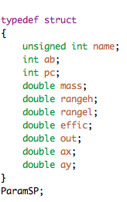
C program – Optimisation
Optimisation : Algorithm + Memory + Data structure
Struct
List
X
123
446
...
...
062
&187
&123
&446
&...
&062
Fast remove and add elements
Resident species
(list of struct)
Notes:
Montrer du code (assembly / intégration)

Slide 57
Preliminary results – diversity
1 simulation
local diversity
assembly steps

Slide 58
Preliminary results – diversity
50 simulations
local diversity
+
Efficiency of recycling
assembly steps
Notes:
montrer un assemblage

Slide 59
Preliminary results – Biomass
50 simulations
biomass
assembly steps

Slide 60
Preliminary results – BEF
50 simulations
biomass
local diversity

Slide 61
Ecosystem Assembly Model
Thank you for your attention

